Slide 1
Learn Python 6
STEM Outreach

Slide 2
Agenda
What are you guys learning in Math or Science right now, in School?
Olympic Rings exercise
Questions about the exercise, Loops
Functions
Operators
Arithmetic
Assignment
Logical
Comparison
Identity
Membership
Bitwise
Homework – Calculator of your own

Slide 3
Functions
Functions
A function is a block of code which only runs when it is called.
You can pass data, known as parameters, into a function.
A function can return data as a result.
In Python a function is defined using the def keyword:
Basic Functions: https://bit.ly/3l614kx
Parameters: https://bit.ly/31jAWLg
Multiple Parameters: https://bit.ly/3hmRRlU
Unknown Parameters: https://bit.ly/34mdbEj
Keyword Arguments: https://shorturl.at/gzHJT
Default Params: https://shorturl.at/iMSVY
Passing List in a function: https://shorturl.at/lpCEH
Returning a value: https://shorturl.at/blqI0

Slide 4
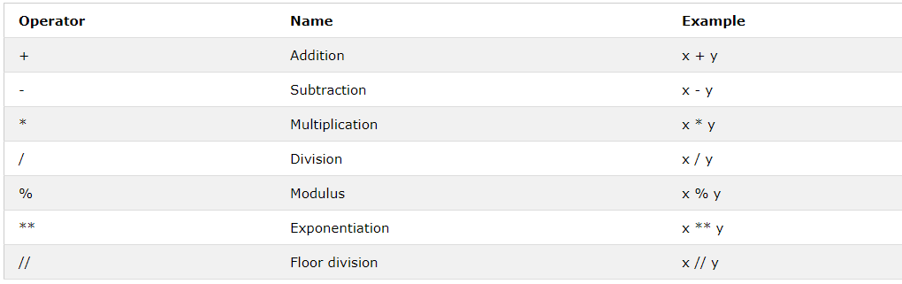
Operators - Arithmetic

Slide 5
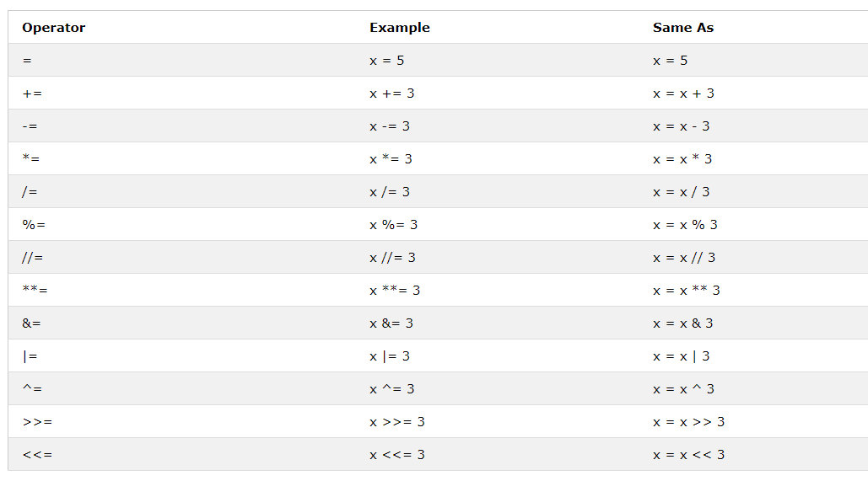
Operators – Assignments

Slide 6
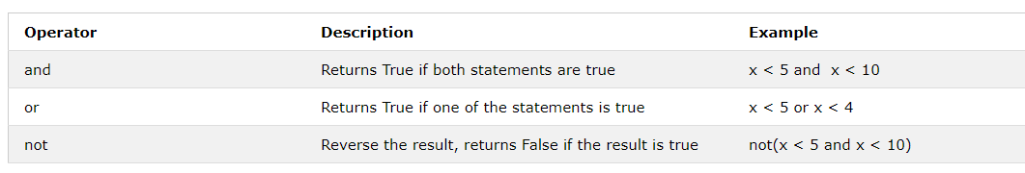
Operators - Logical

Slide 7
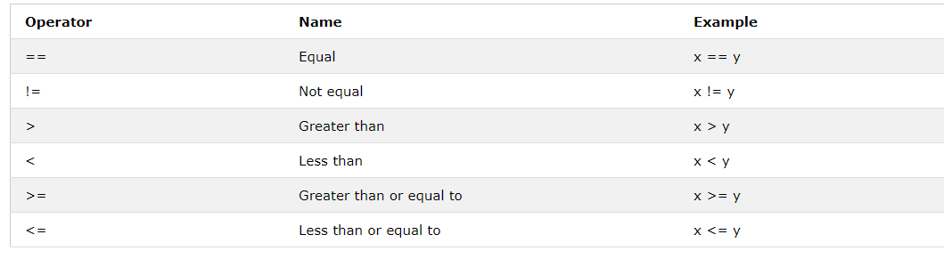
Operators - Comparison

Slide 8
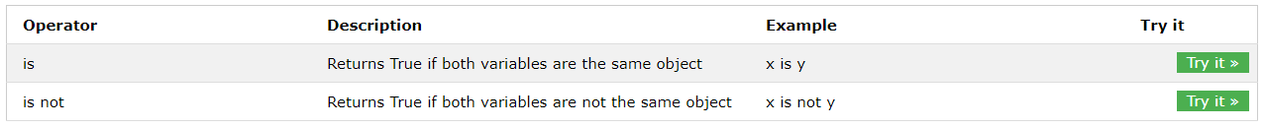
Operators – Identity

Slide 9
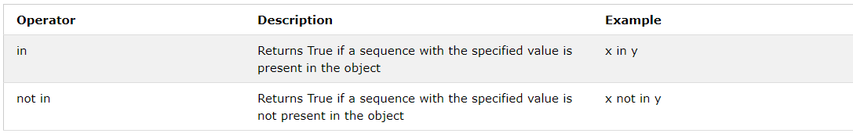
Operators - Membership

Slide 10
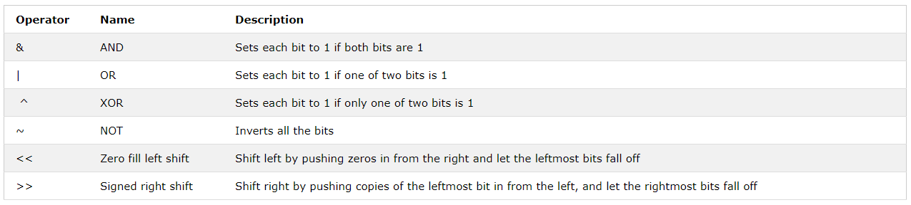
Operators - Bitwise

Slide 11
Homework
Converter
All of these should take an input to figure out what the user wants to do
Remember for unit conversion, you will need to specify the unit user wants to convert from and convert to
Remember to use functions, it will make this a lot easier
Add
Subtract
Multiply
Divide
Temperature Converter: C → F, F → C, K → C
Unit Conversions: mi → km, pounds → kgs, liters → gallons
Areas: Circle, Square, Triangle

Slide 12
Questions/Feedback

